Slide 1


Analyzing Customer Preferences and Restaurant Performance Using Zomato Dataset
• Dhai Hisham Ibrahim Manaa • Christine Gabrail Saad Botros • Sara Amr Ismail Salama • Nadine Ehab Jomaa Muhammed • Nouran Tarek Youssef Mahra
Supervised by Dr. Ahmed Abd-Allatef
With the generous support of AST company

Slide 2
In Today’s competitive food industry, understanding customer preferences is essential. Zomato, a leading restaurants platform, provides valuable data to explore what makes restaurants successful and how pricing varies across cities. This project analyzes the Zomato dataset to uncover key restaurant trends and customers insights.

Slide 3
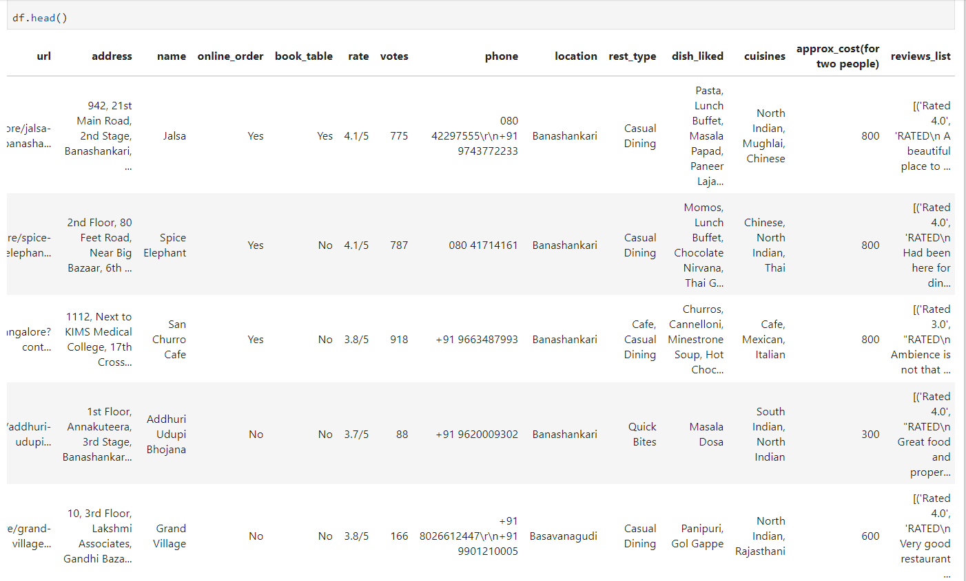
The dataset contains information on restaurants, includes their names, locations, ratings and more. With over than 51,000 records and 17 columns.

Slide 4



The Goal of This Analysis
Identifying factors that contribute to high restaurant ratings
Understanding how location impacts restaurant prices and ratings.
Discovering trends in restaurant categories and customer preferences.

Slide 5
Data Cleaning
a- Handling missing values.
c- Handling unique values.
b- Handling duplicates.
d- Renaming columns.

Slide 6
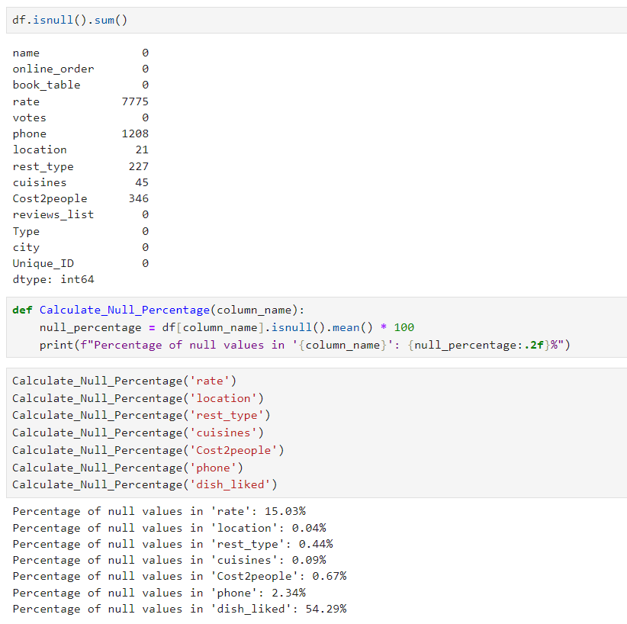
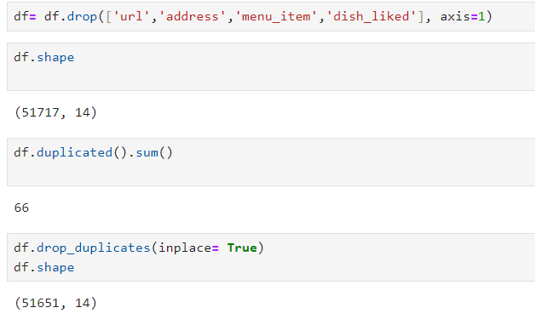

Dealing with Messing and Duplicated Values

Slide 7
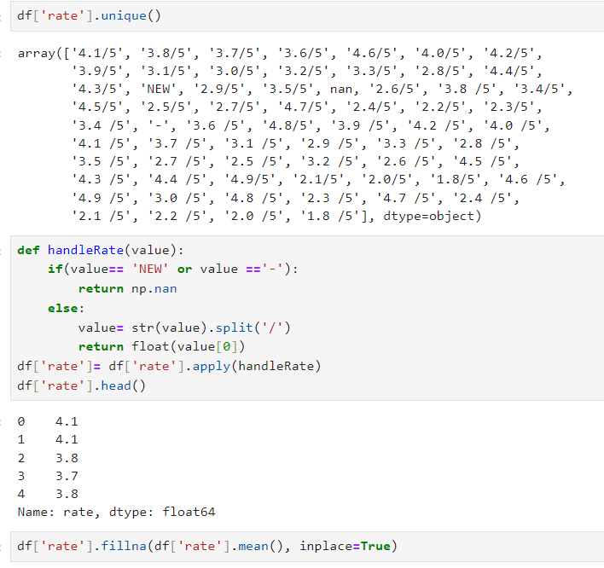
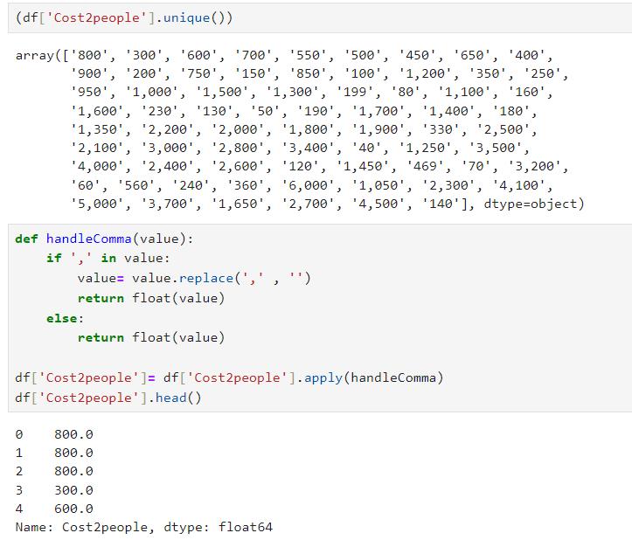
Dealing with Unique Values in Columns

Slide 8
Exploratory Data Analysis

Slide 9
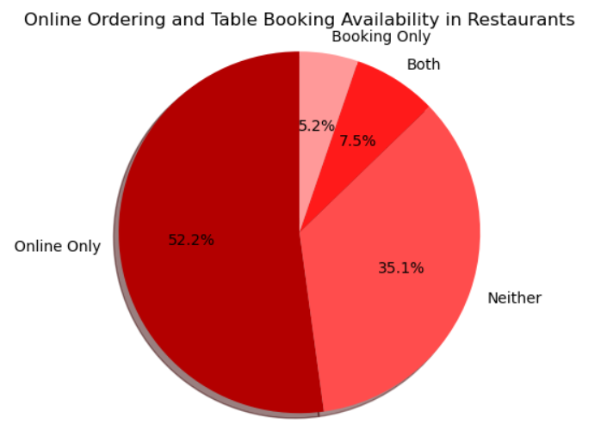
Almost half of the restaurants offer online ordering, while only 5% provide booking services, and less than 10% offer both. Approximately 35% of the restaurants do not provide either service.

Slide 10
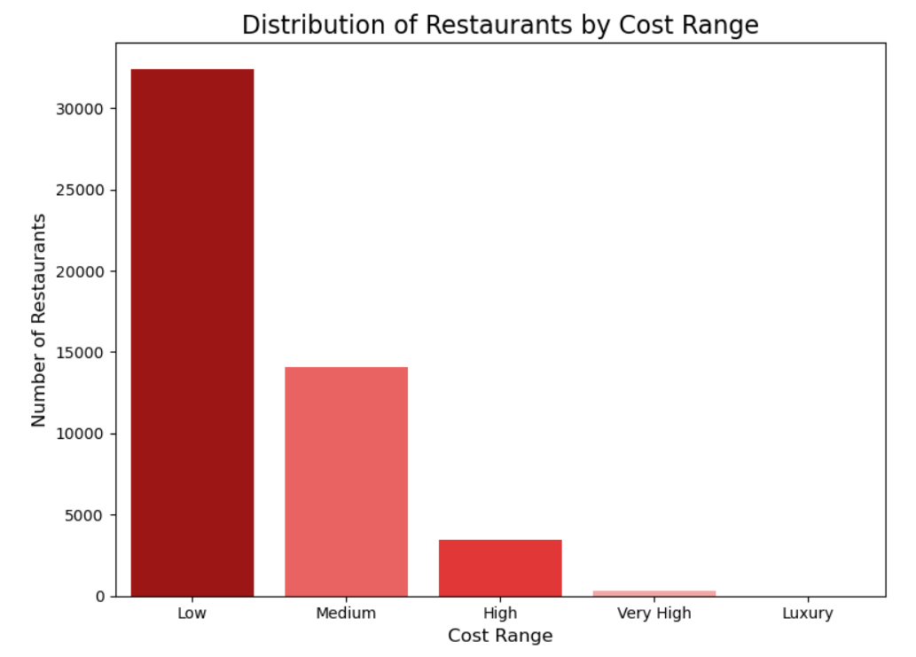
Almost 80% of the restaurants offer affordable meals for two people, with prices falling into the low to medium range. The remaining 20% are priced in the high to very high range

Slide 11
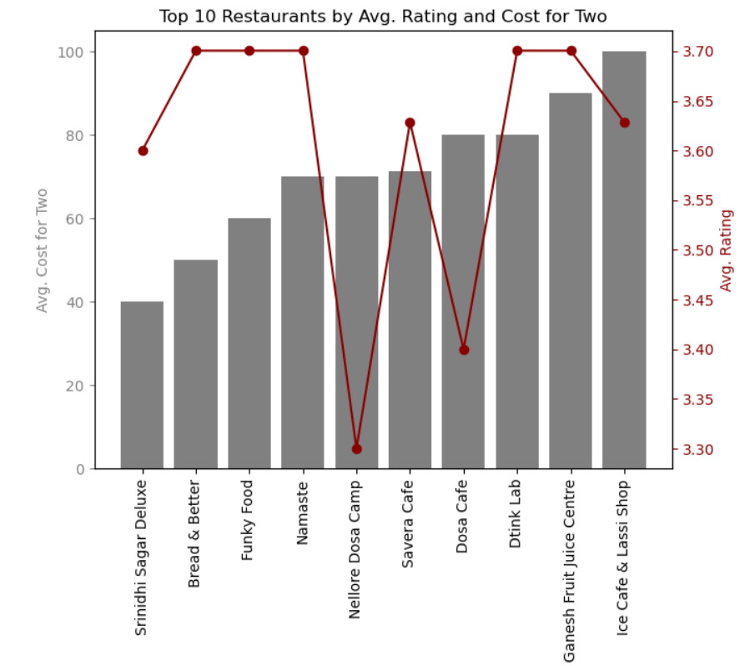
Each restaurant shows a different relationship between cost and rating. For instance, Sindhi Sagar Deluxe has one of the lowest costs and moderate ratings, while Nellore Dosa Camp has the lowest rating despite having a higher cost. This visualization helps in analyzing how cost impacts customer ratings across these restaurants.
The chart compares the top 10 restaurants based on two variables: the average cost for two people (represented by bars) and the average rating (represented by the red line).

Slide 12
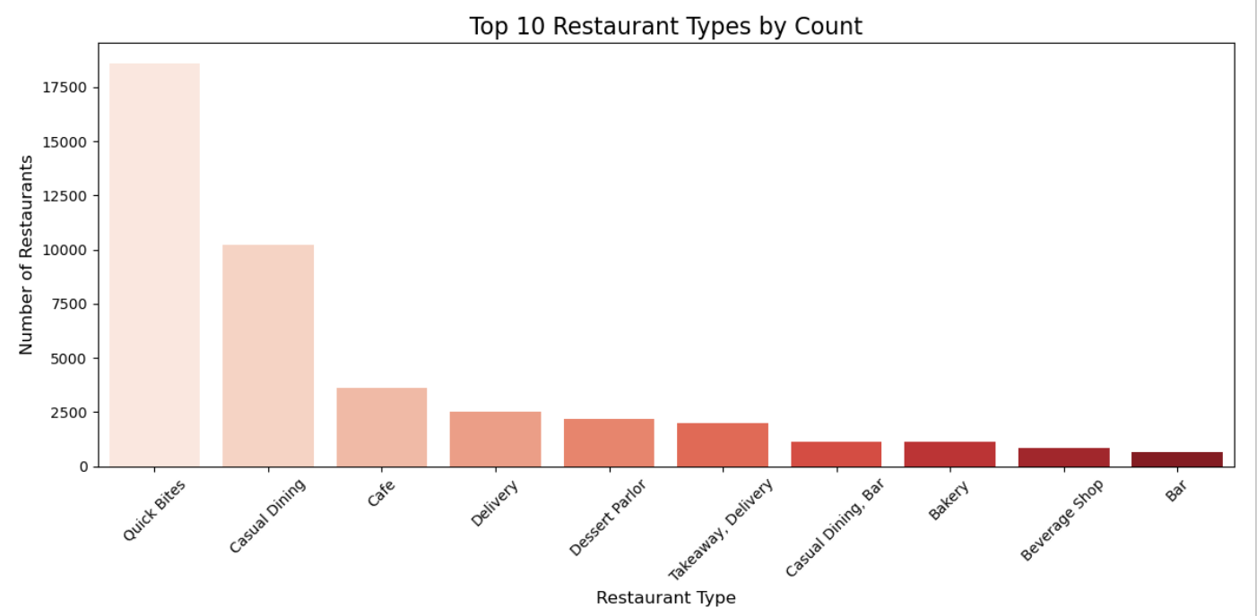
The most popular restaurant type is "Quick Bites," while the least popular is "Bar." This trend may be attributed to people's preference for quick meals due to fast-paced lifestyles and hectic schedules.

Slide 13
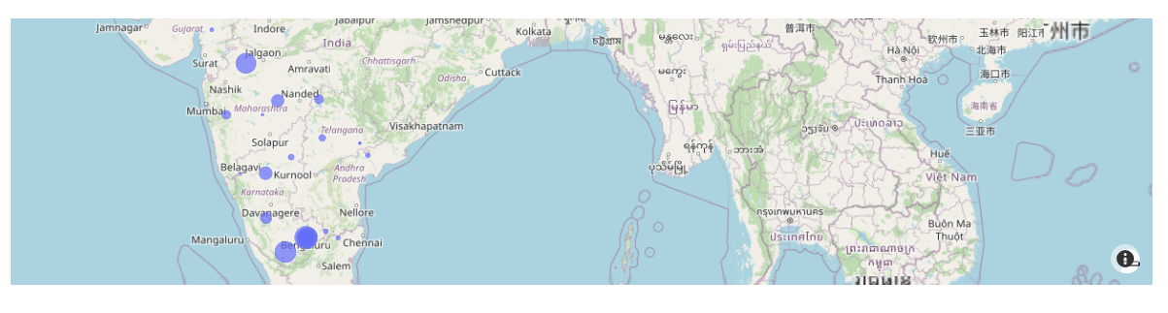

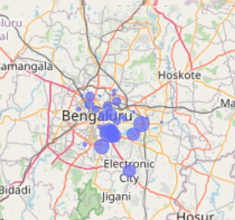
1- The majority of restaurants are clustered in Bengaluru.
Map of Restaurant Count by Location
2- Potential restaurant owners can use this information to identify good locations for their ventures.

Slide 14
Machine Learning Model
Goal: Predict restaurant success (ratings) based on features like online_order, book_table, Cost2people, votes, and encoded categorical features (rest_type, cuisines, location).
Model: Random Forest Regressor

Slide 15
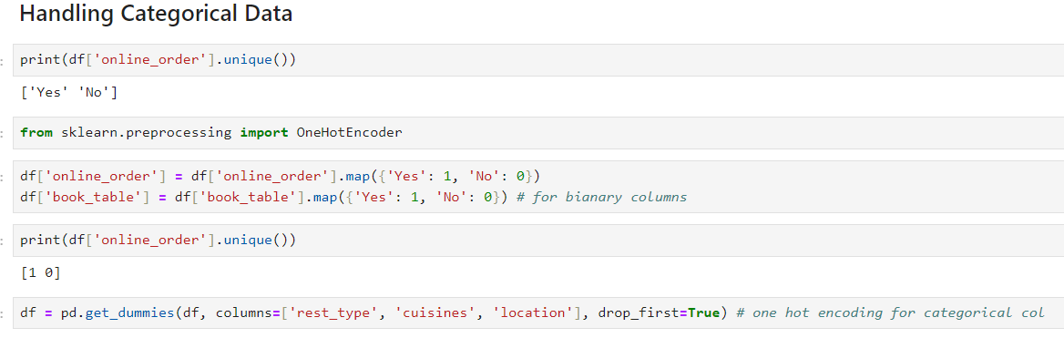
Step one :Handling Categorical Data

Slide 16
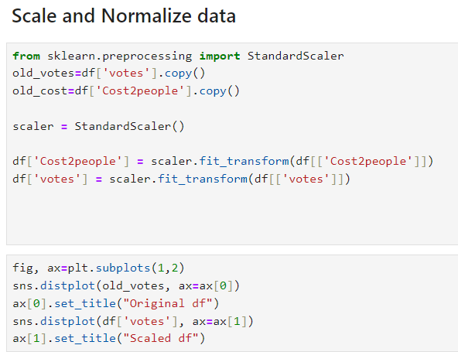
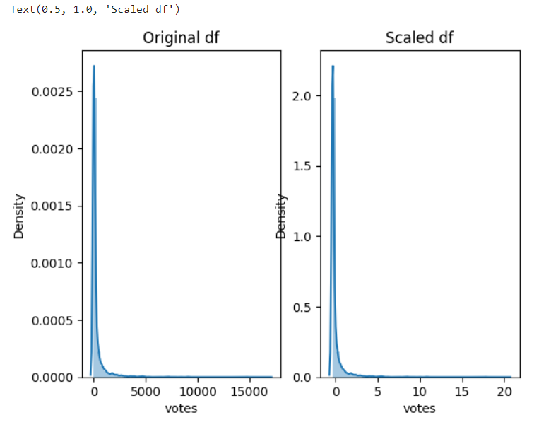
Step Two :Scale and Normalize Data

Slide 17
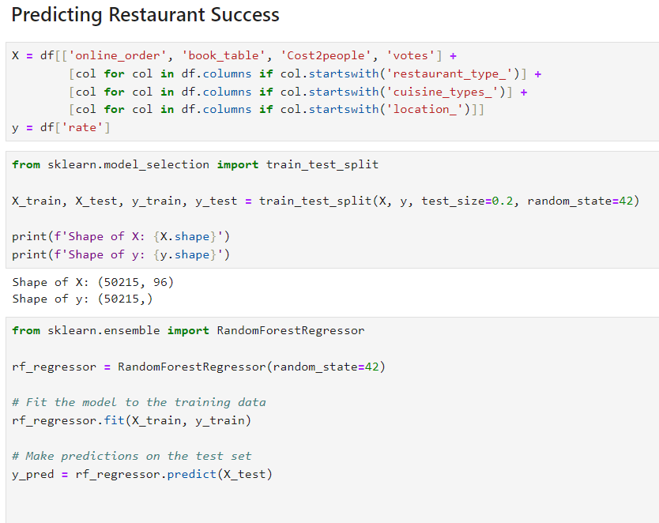
Step Three :Predicting Restaurant Success

Slide 18
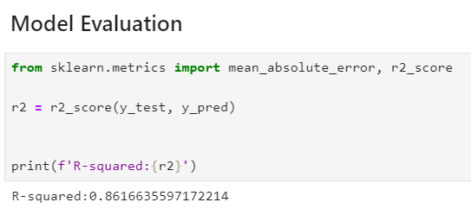
Step Four :Model Evaluation

Slide 19
Dashboards
We used Tableau to build insightful dashboards

Slide 20
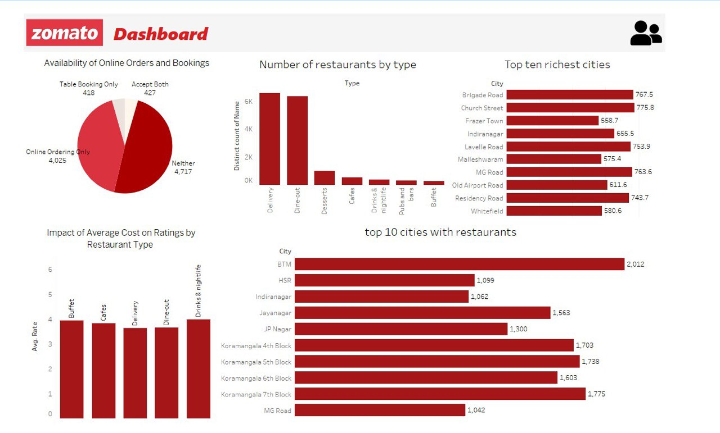

Slide 21
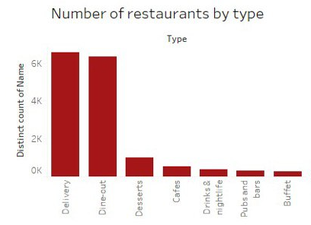
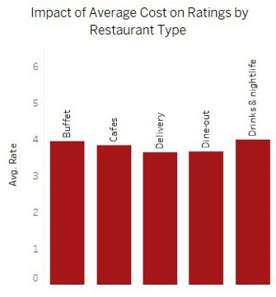
Key Insights Recap:
- Delivery and dine-out dominate, indicating high customer demand for these formats.
- Buffets and bars are relatively rare, which may suggest niche market opportunities.
- Higher average costs, like those for nightlife spots, tend to have better ratings, showing a positive correlation between price and perceived quality.

Slide 22
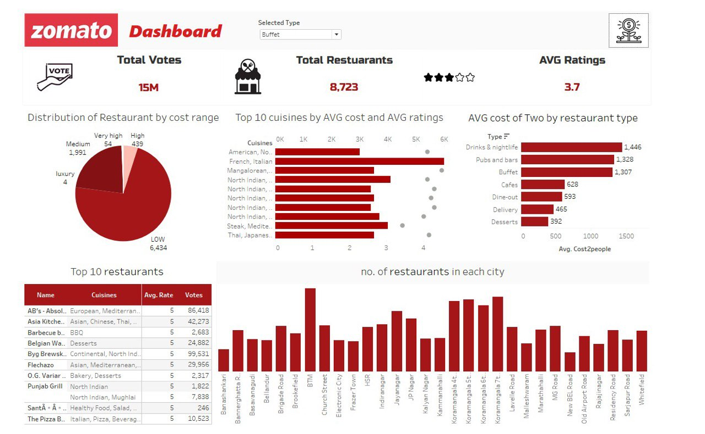

Slide 23
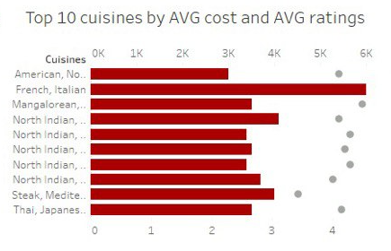
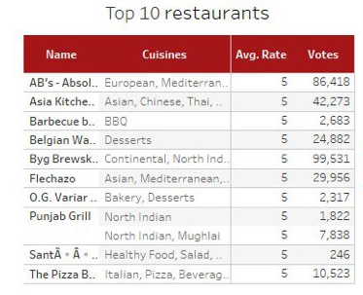
Key Insights Recap:
- American and North Indian cuisines dominate, with American cuisine being the most expensive on average.
- Restaurants with higher votes and ratings serve a diverse set of cuisines, suggesting that variety can attract more customers.

Slide 24
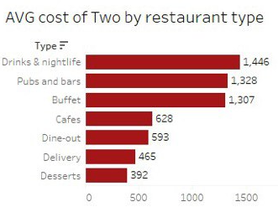
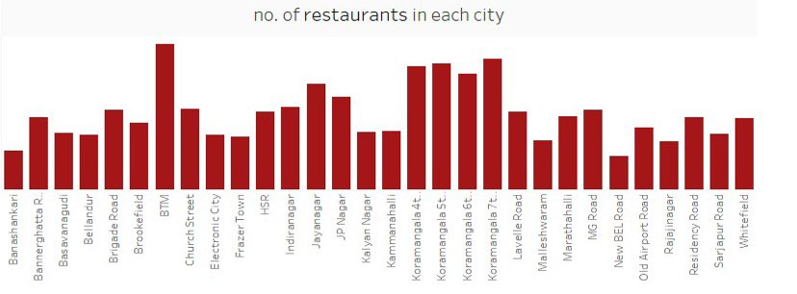
Key Insights Recap:
Nightlife and pubs have the highest average costs, aligning with their premium positioning
Koramangala blocks(well-known neighborhood located in Bengaluru) have a dense concentration of restaurants, indicating intense competition in those areas

Slide 25
Recommendations & Business Implications:
• For businesses: Restaurants in highly competitive areas like Bengaluru should focus on differentiating their services to attract customers.
• Adding Services: Restaurants that don’t offer table bookings might benefit from expanding their offerings to improve customer engagement.
• Nightlife Options: Cities with a lack of nightlife or buffet options could introduce these formats to attract higher-spending customers.
• Location Strategy: Businesses expanding to Koramangala should plan for competitive strategies to stand out in a saturated market.
• Cuisine Focus: Focusing on popular cuisines like North Indian or introducing a unique cuisine can attract more customers.

Slide 26

Thank you for your attention! Do you have any questions about our dashboards, insights, or recommendations?

